Slide 1
Introducing myself: Aryan Ritwajeet Jha
Advisor: Anamika Dubey
PhD Thesis Topic: Scalable Multi-Period Optimal Power Flow in Active Distribution Systems
Or simply, Scalable MPOPF in ADS
Notes:
Remember to hit the reset button to make sure all the page elements react properly.
There are 20 different layouts that you can choose from.

Slide 2



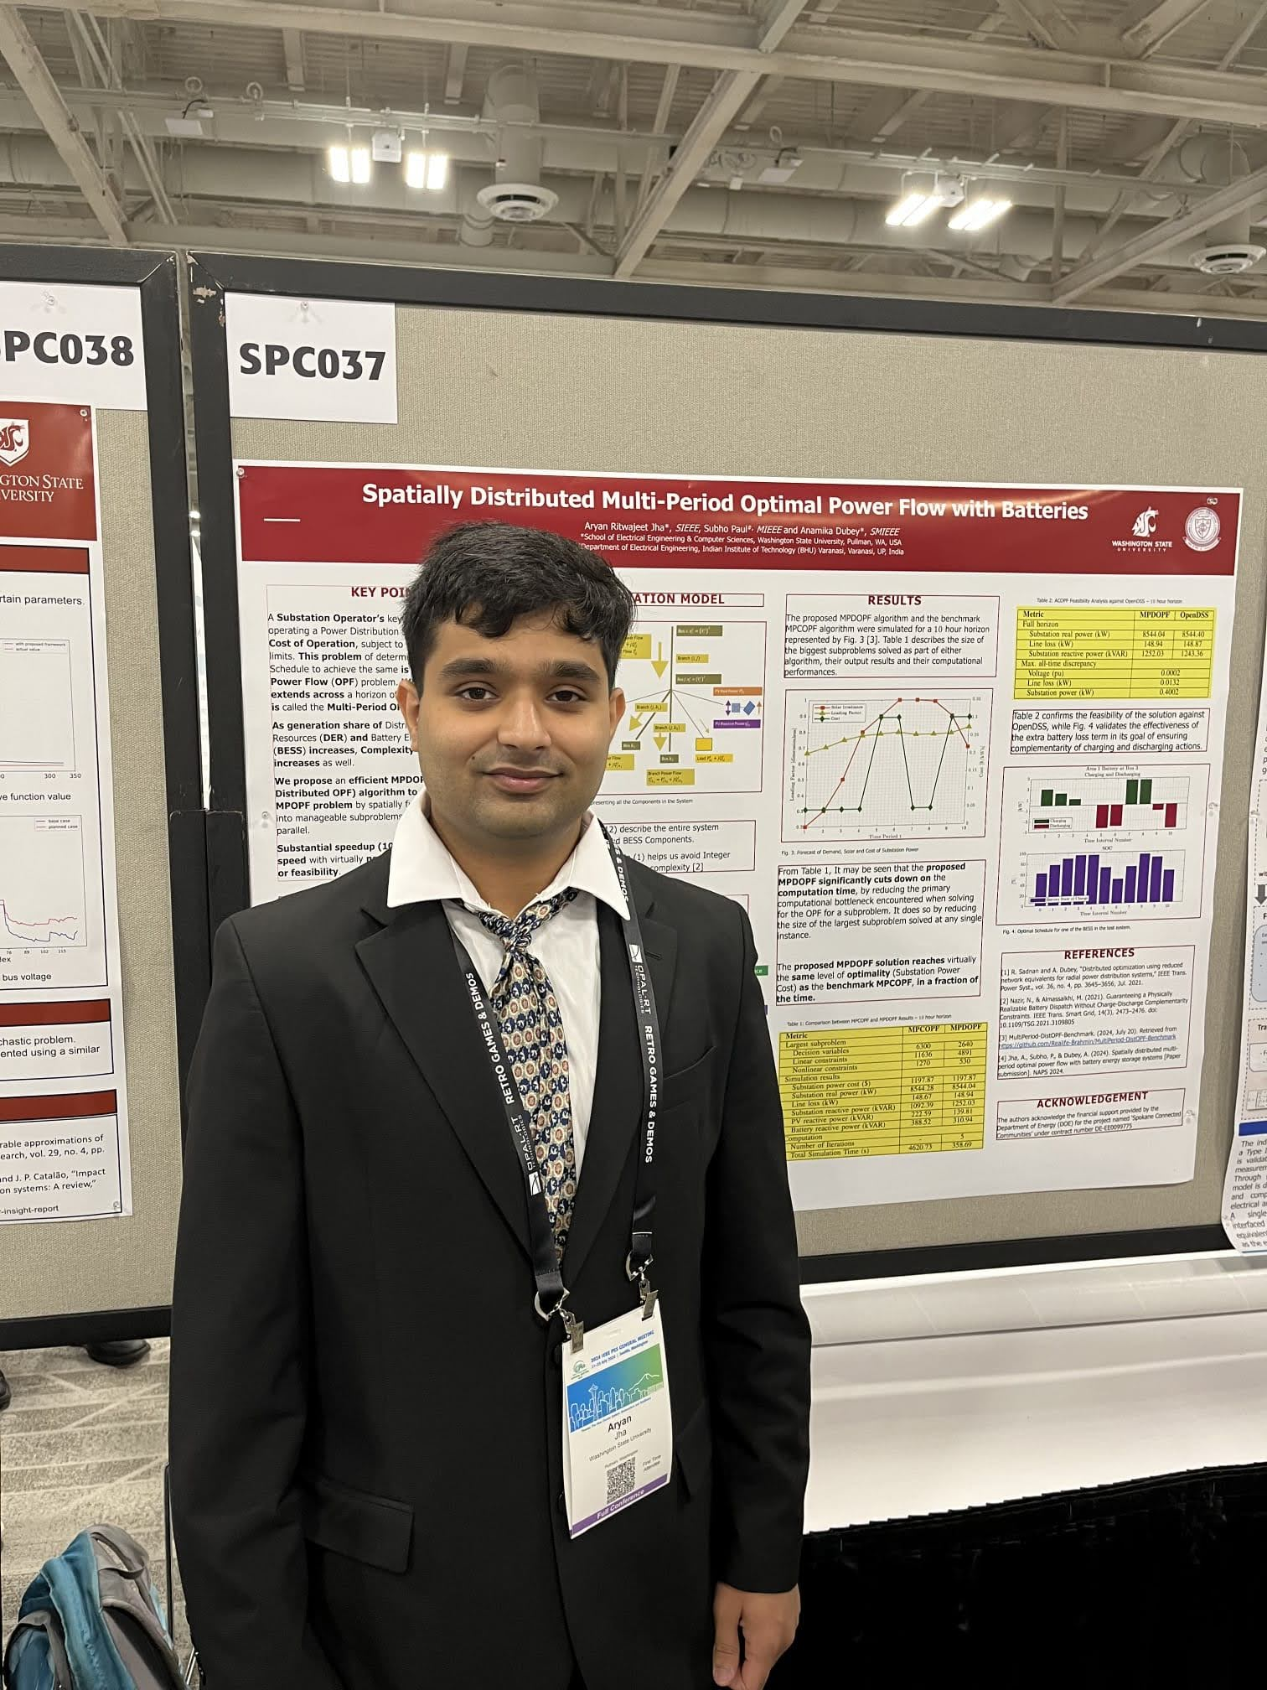
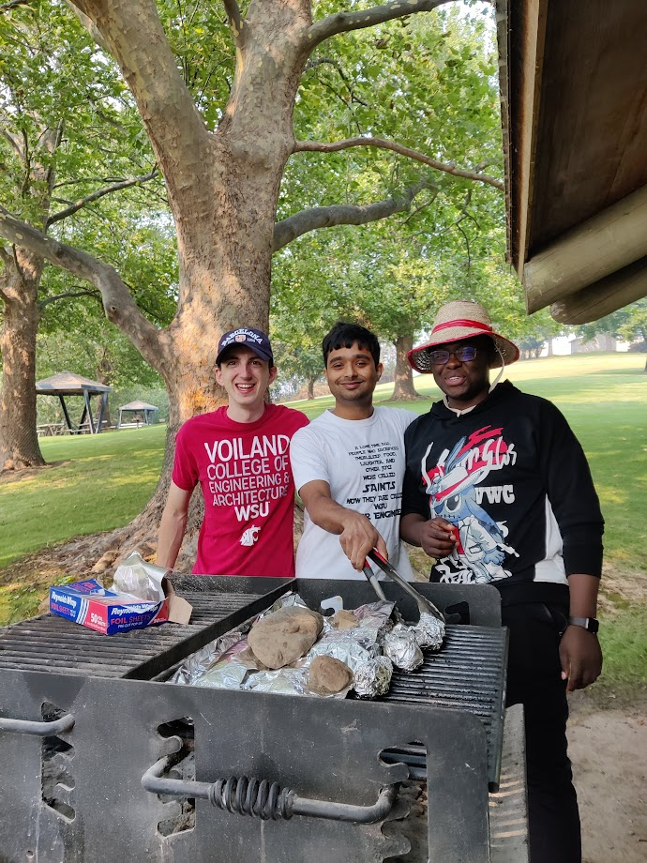
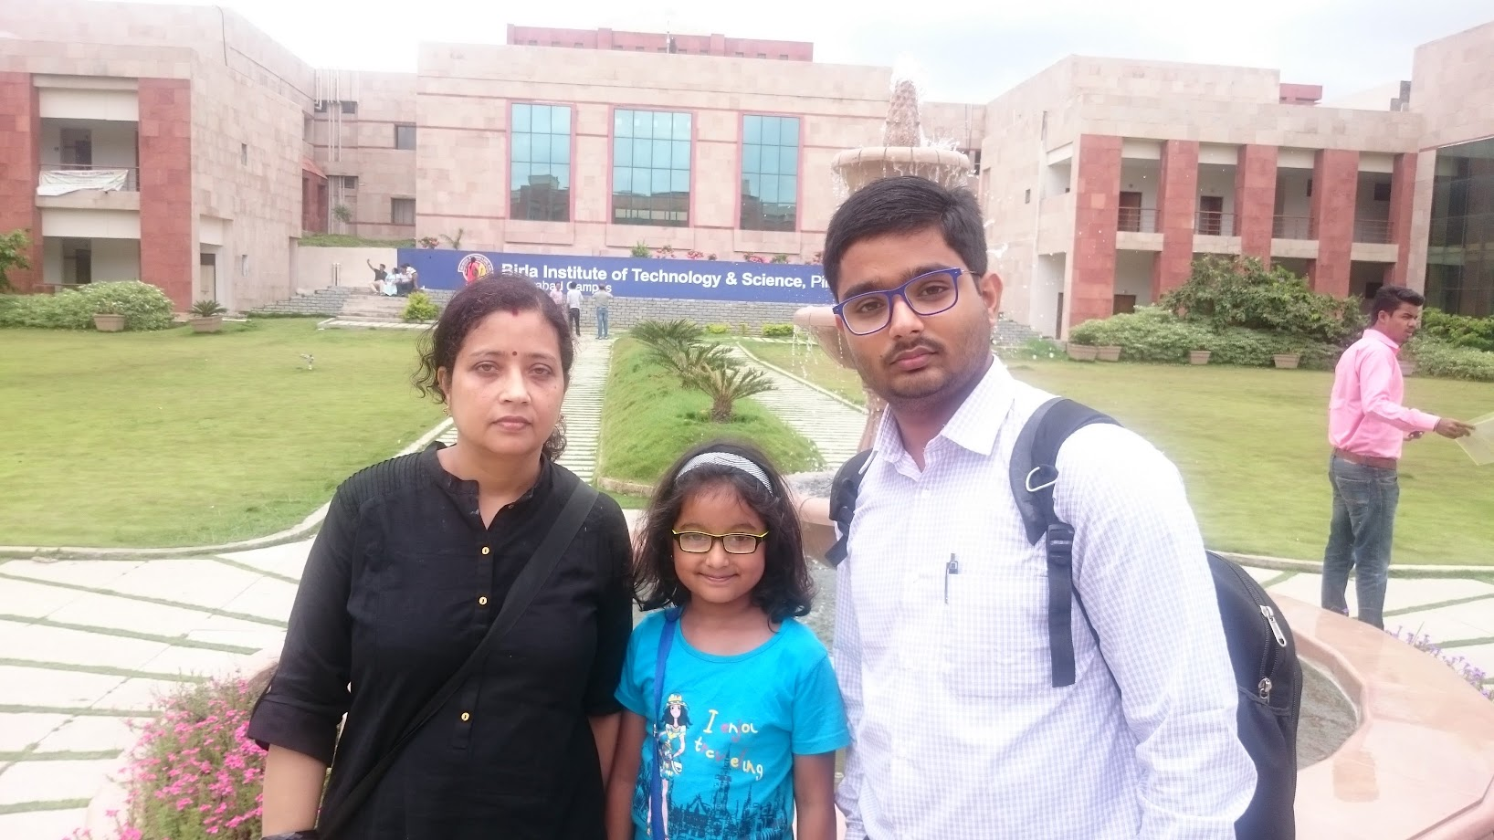
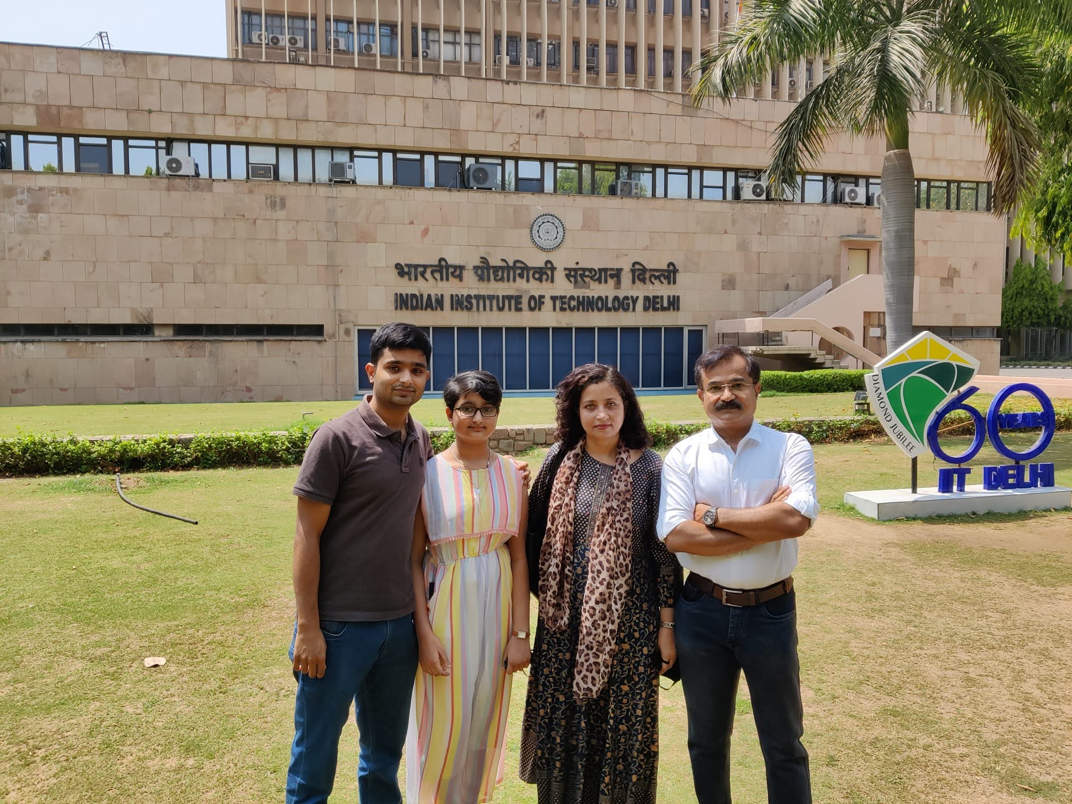


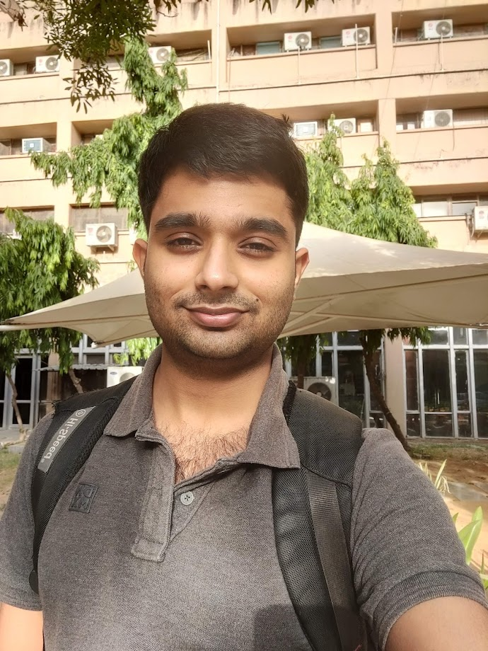

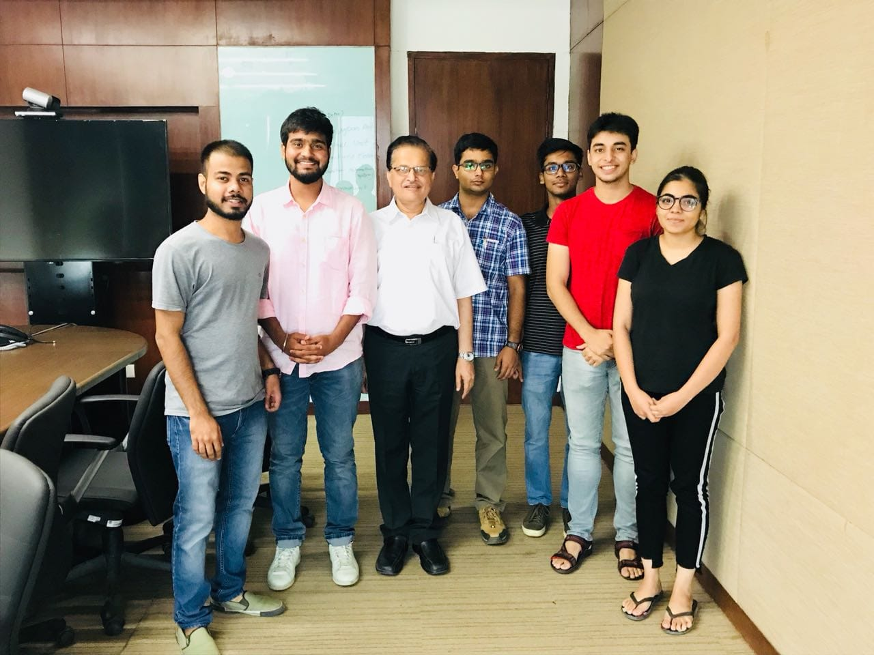

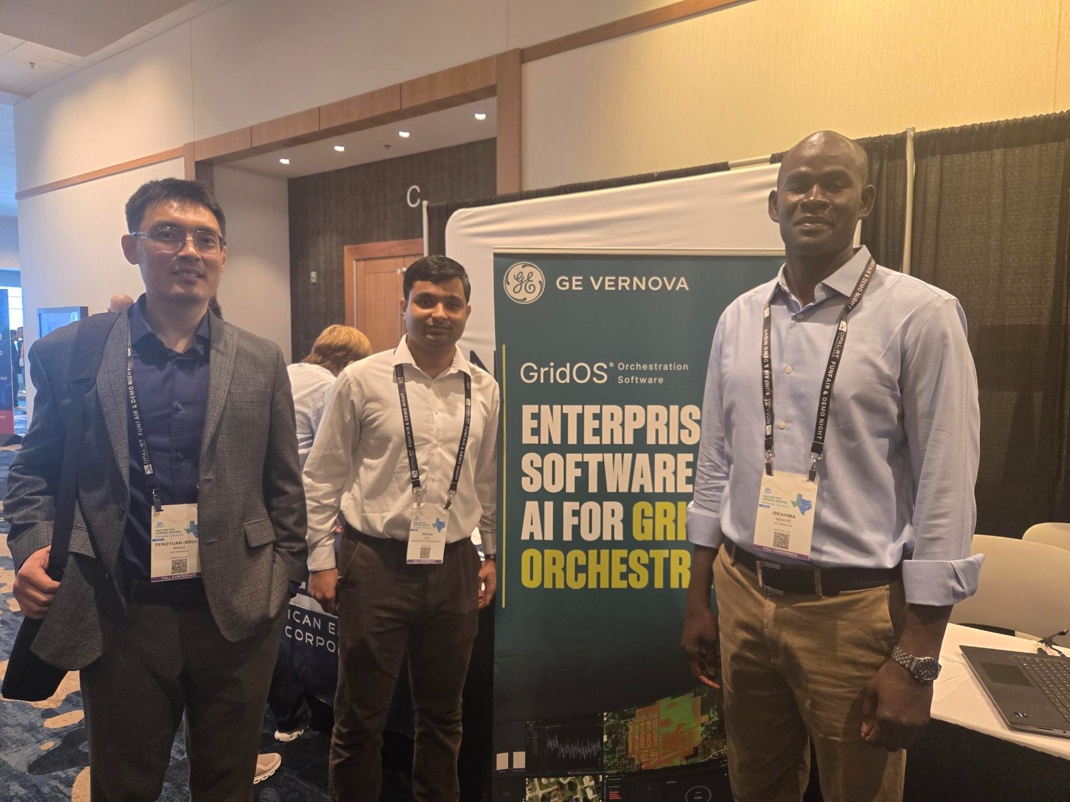

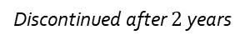

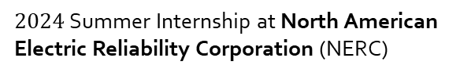

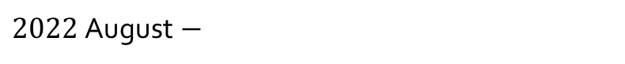
Bachelor of Engineering in EEE at BITS Pilani, Hyderabad Campus
Master of Science (Research) in EE (Power Systems) at IIT Delhi
Pursuing PhD ECE (Power Systems ) at Washington State University, Pullman, WA
$2024$ Summer Internship at North American Electric Reliability Corporation (NERC)
$2018$ Summer Internship at Power Grid Corporation of India, Gurgaon
$2025$ Summer Internship at GE Vernova Advanced Research Center (GEVARC)
Discontinued after $2$ years
$$2016 −2020$$
$$2020 −2022$$
$2022$August$−$

Slide 3
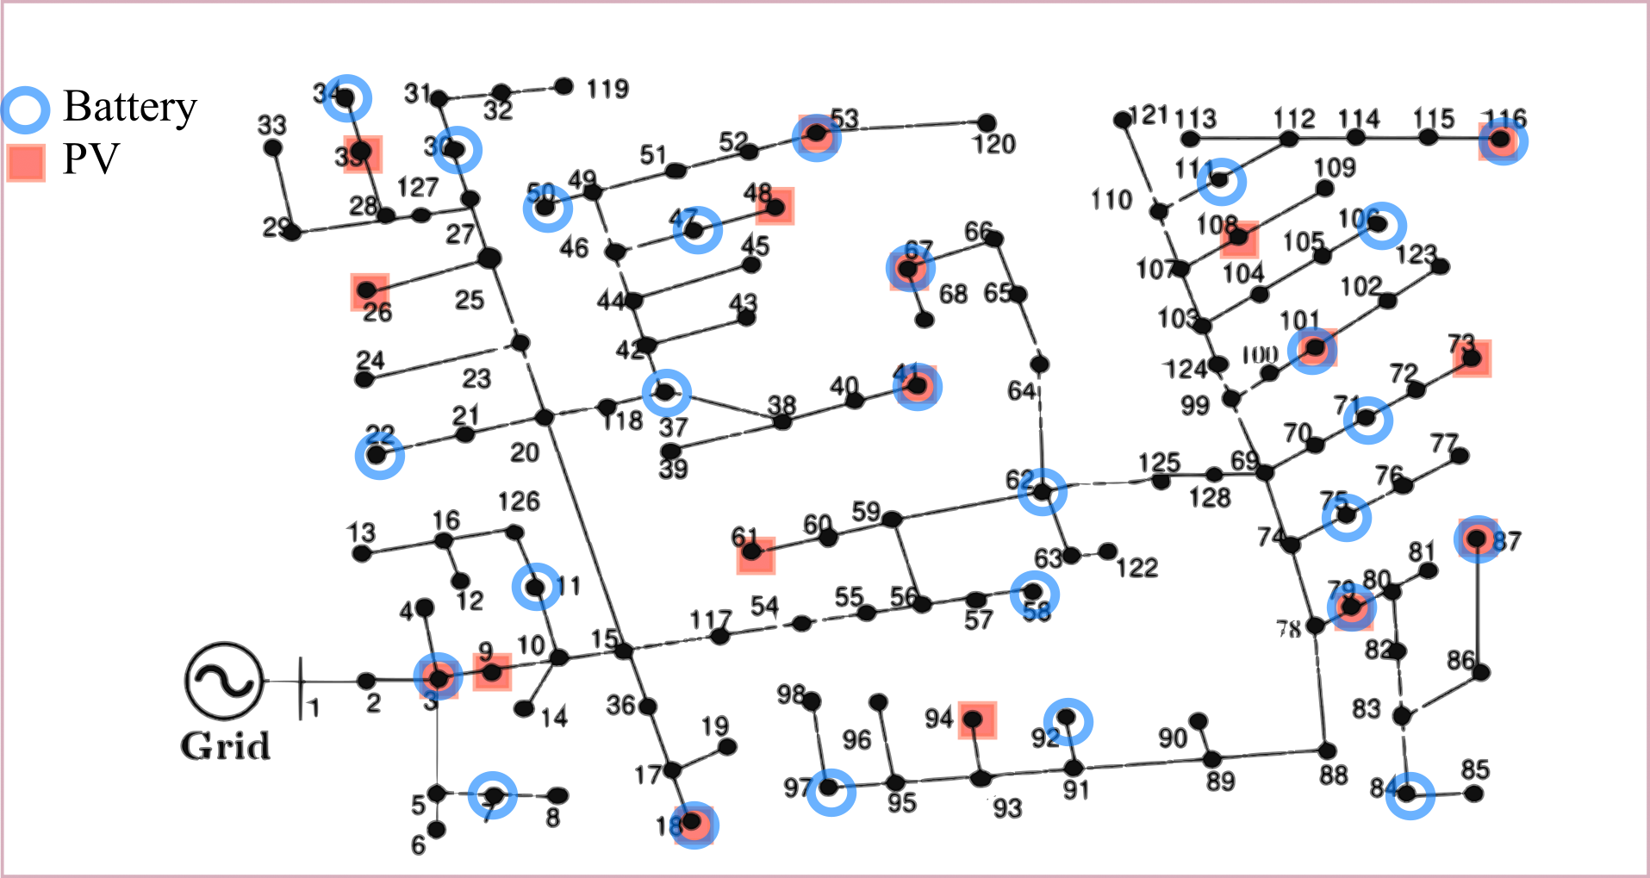
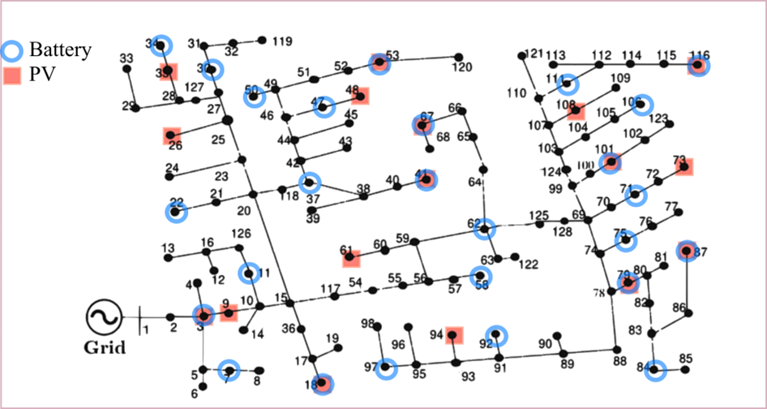
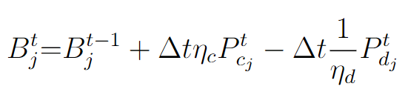


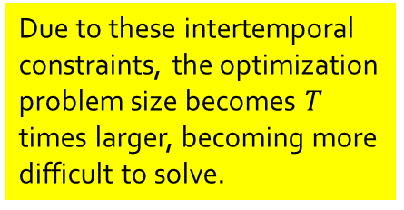
The Multi Period Optimal Power Flow (MPOPF) problem for Active Distribution Systems
$min.$Desired Objective Function
Controllable Components: Grid Edge Devices (GEDs) like Batteries and PVs spread throughout whose real and reactive dispatch may be set every time-period
$$subject to$$
Network Constraints
Engineering Constraints
Component Constraints (DERs, Batteries)
Intertemporal Constraints
Intertemporal Constraints
Intertemporal Constraints
Set Points
Set Points
Set Points
Due to these intertemporal constraints, the optimization problem size becomes $T$ times larger, becoming more difficult to solve.
Battery SOC Equation

Slide 4
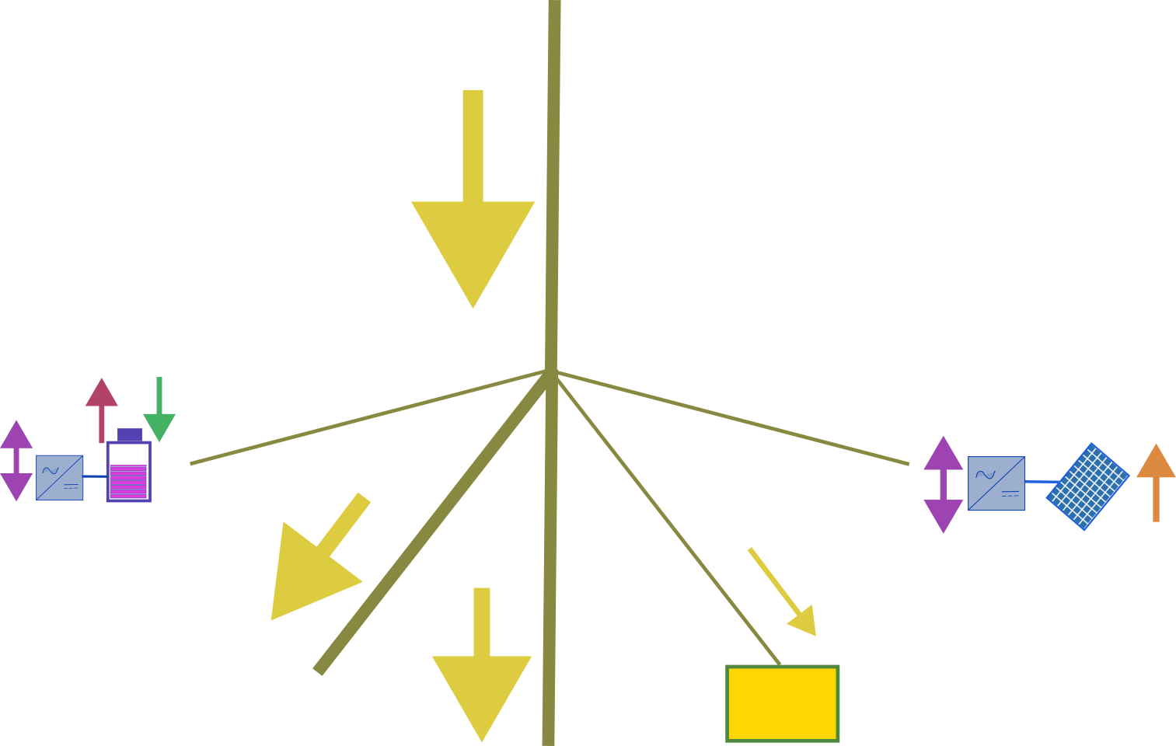
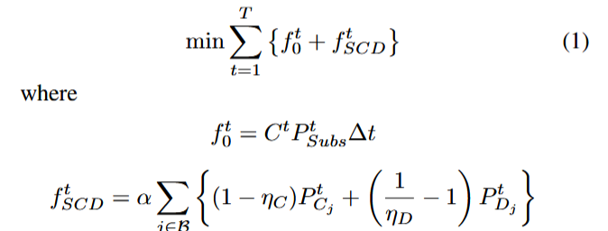
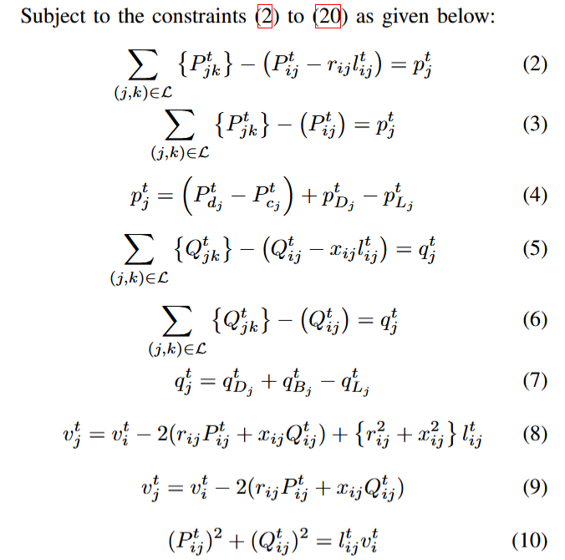
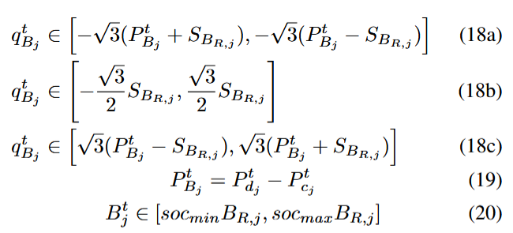
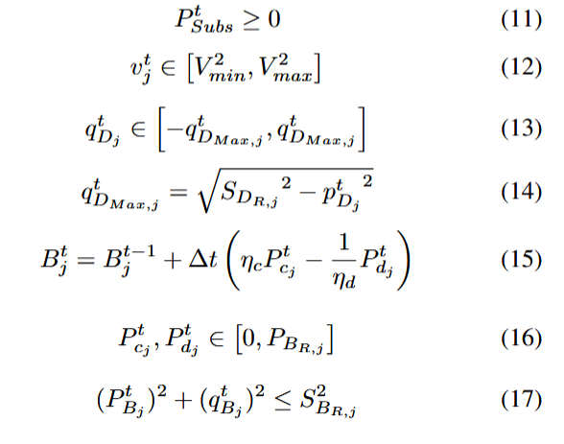
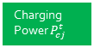



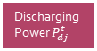
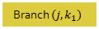

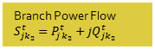
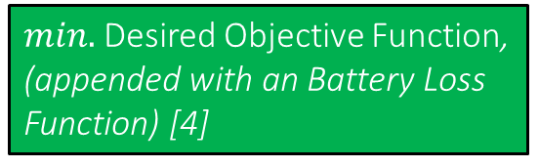
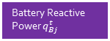


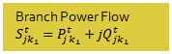



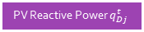
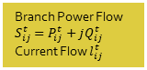
Full Optimization Model – Balanced Three-Phase Nonlinear/Linear OPF
Bus $i$:$v_{i}^{t}={\left(V_{i}^{t}\right)}^{2}$
Branch Power Flow $S_{ij}^{t}=P_{ij}^{t}+jQ_{ij}^{t}$
Current Flow $l_{ij}^{t}$
Branch $(i, j)$
$min.$Desired Objective Function, (appended with an Battery Loss Function) [4]
Objective
Discharging Power $P_{dj}^{t}$
Charging Power $P_{cj}^{t}$
Bus $j$:$v_{j}^{t}={\left(V_{j}^{t}\right)}^{2}$
PV Real Power $P_{Dj}^{t}$
Battery Reactive Power $q_{Bj}^{t}$
Branch $(j, k_{1})$
$$subject to$$
Branch $(j, k_{2})$
PV Reactive Power $q_{Dj}^{t}$
Network Constraints
Network Constraints
Bus $k_{1}$
Engineering Constraints
Branch Power Flow $S_{jk_{1}}^{t}=P_{jk_{1}}^{t}+jQ_{jk_{1}}^{t}$
Bus $k_{2}$
Load $P_{Lj}^{t}+jQ_{Lj}^{t}$
Component Constraints (DERs, Batteries)
Branch Power Flow $S_{jk_{2}}^{t}=P_{jk_{2}}^{t}+jQ_{jk_{2}}^{t}$
Battery Reactive Power Constraints
PV and Battery Real Power Constraints

Slide 5
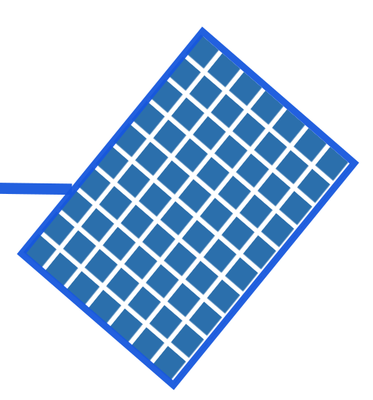
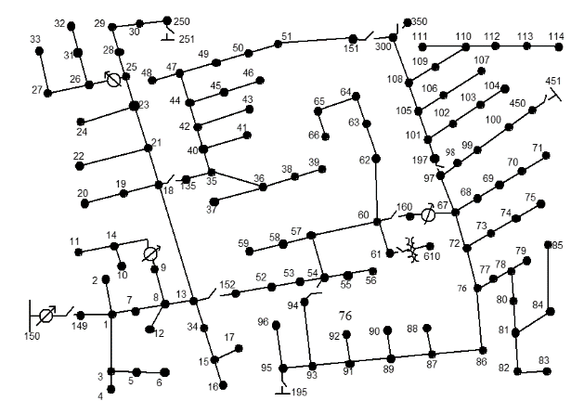
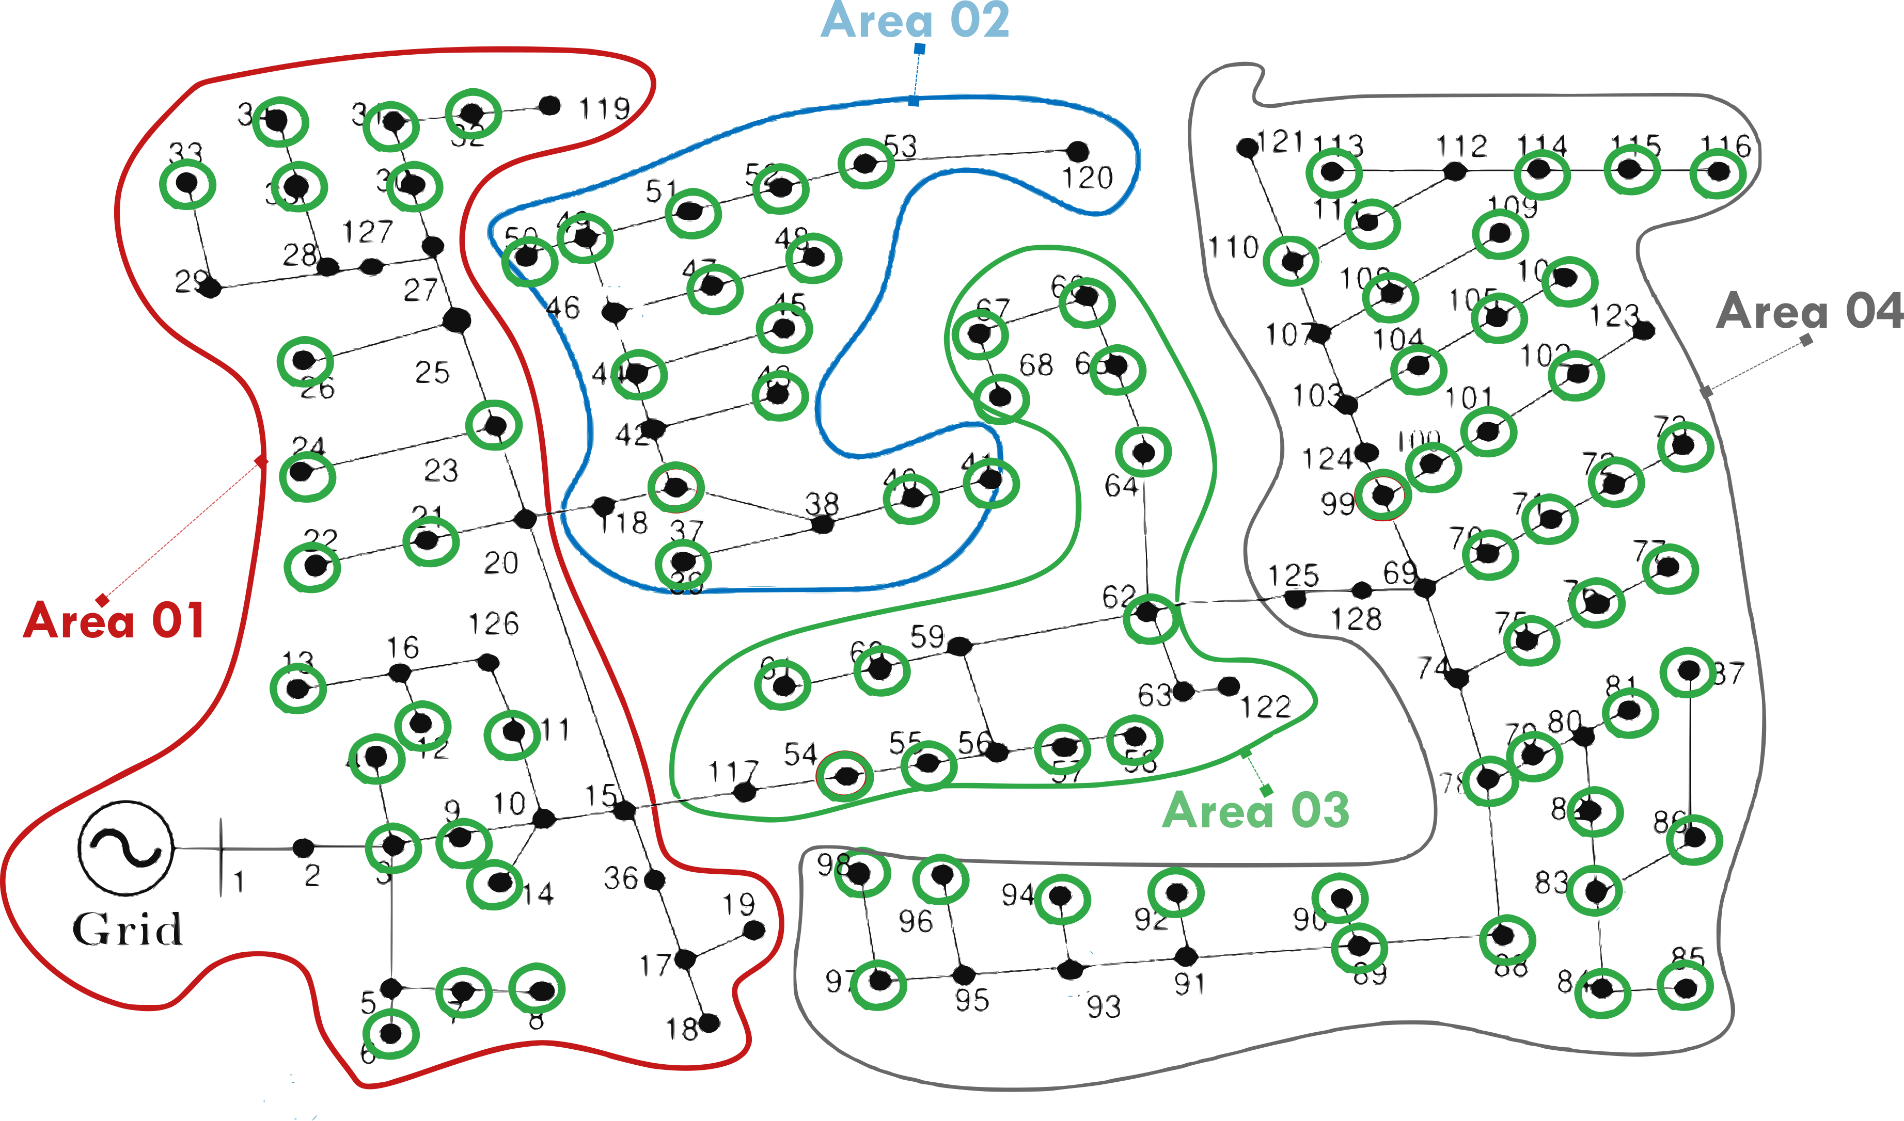


MPOPF Problem Decomposition - Spatial
Previously utilized* and proven to cut down computational costs!
*A. R. Jha, S. Paul and A. Dubey, "Spatially Distributed Multi-Period Optimal Power Flow with Battery Energy Storage Systems," 2024 56th North American Power Symposium (NAPS), El Paso, TX, USA, 2024, pp. 1-6, doi: 10.1109/NAPS61145.2024.10741846.*

Slide 6
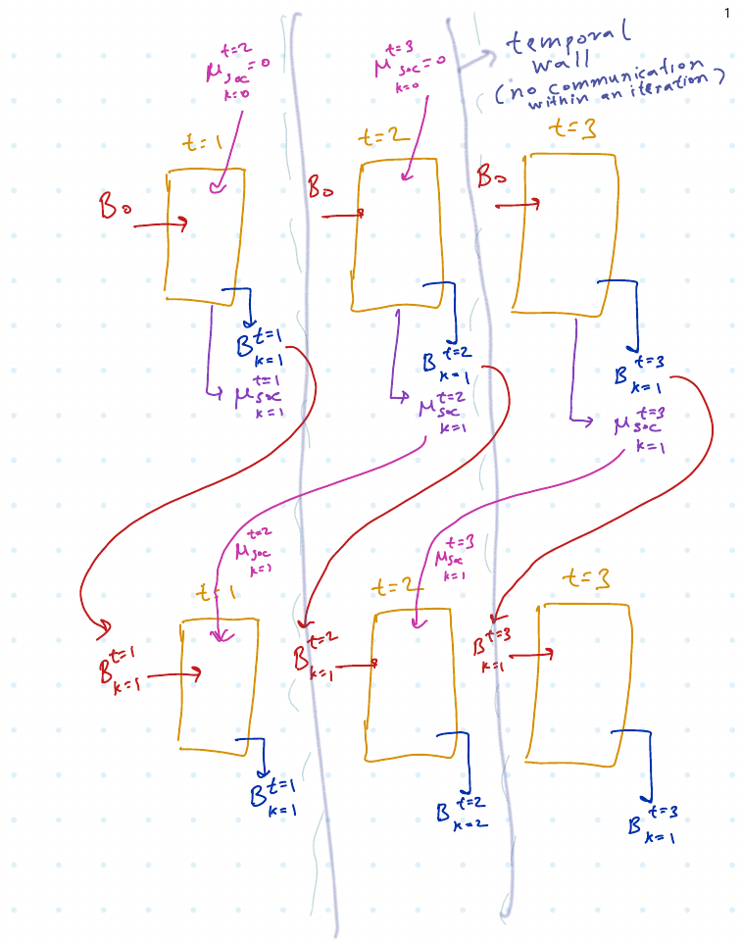
MPOPF Problem Decomposition - Temporal
Tested with good results!
Currently being perfected..

Slide 7

My reasons to take/ My expectations from EE $582$

Slide 8

Slides End Here. Thank you!

